Slide 1
Machine Learning

Slide 2
What is machine learning?
Creating computer programs that can “learn,” that is, they improve their performance by leveraging data to perform one or more tasks.
This is in contrast to “regular programs” or programs that don’t learn: they must be programmed to do their tasks.

Slide 3
Syllabus things
Website: pkirlin.github.io/ml-s23/
Textbook: none, but there will be readings posted
Prerequisites: math math math

Slide 4
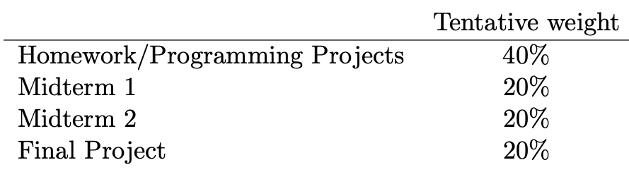
Coursework

Slide 5
Working independently
Out-of-class assignments must be done independently, however, you may ask others for help.
Rule 1: Do not look at anyone else's code for the same project or a similar project.
Rule 2: Do not write code or pseudocode with anyone else. (This now includes ChatGPT!) ☺

Slide 6
Late Work and Makeups

Slide 7

Notes:
First time teaching course. This is a brand new course.
Some things may not work. I may go too fast or too slow. Your feedback to me would be really helpful when you think things are going well or poorly.
I apologize in advance for things that don’t work 100% correctly. So if you will cut me a little slack this semester, I will do the same to you. I’m not looking
To jam anyone up with impossible material. At the same time, the course can’t be a cakewalk either. So I’m going to try to walk a fine line here between too hard and too easy, and you’ll let me know how it’s going. Deal?

Slide 8
About Me

Slide 9
About You
Name (what you want to be called)
Pronouns (if you want)
Where you’re from (interpret however you want)
Class year (first-year, sophomore, junior, senior)
Something boring that you have a strong opinion about.

Slide 10
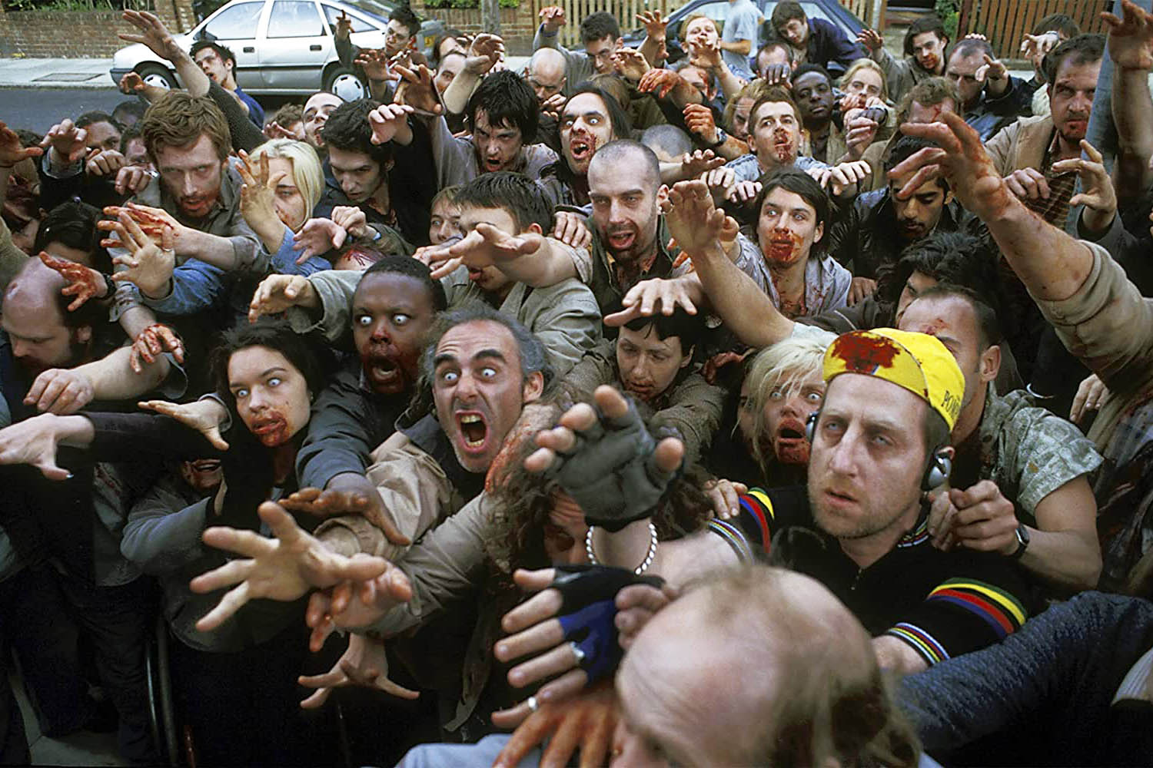
Activity

Slide 11
Activity
Imagine you and your group

Slide 12
What is machine learning?
What comes to mind when you hear the term?
Notes:
In fact, it has been around for decades in some specialized applications, such as Optical Character Recognition (OCR). But the first ML application that really became mainstream, improving the lives of hundreds of millions of people, took over the world back in the 1990s: it was the spam filter.

Slide 13
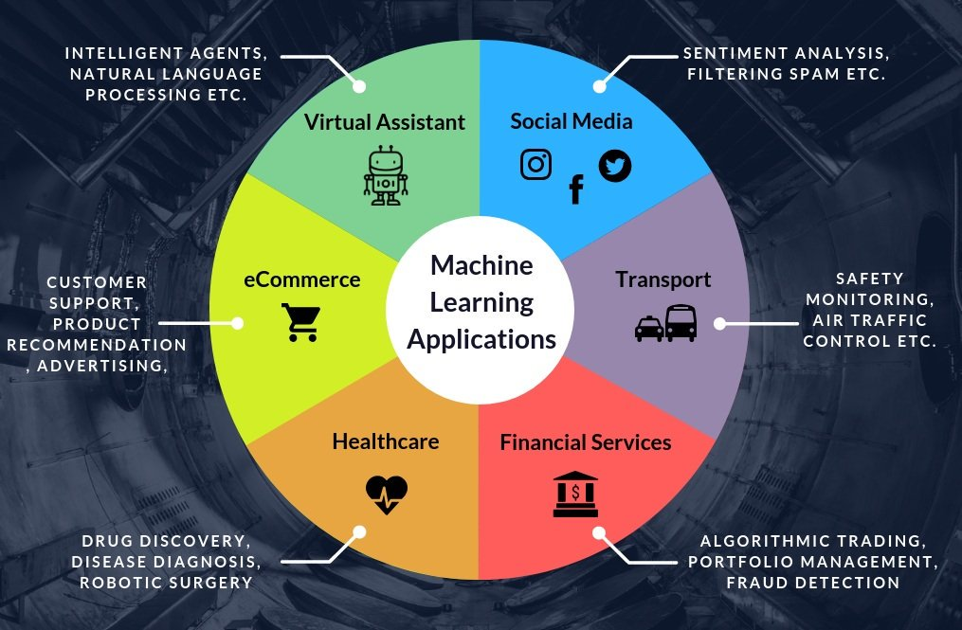

Slide 14

AI in art

Slide 15

AI in art
Notes:
Rhodes college in the snow

Slide 16

Notes:
Bass pro shop pyramid being attacked by aliens

Slide 17
https://deepai.org/machine-learning-model/text2img
https://creator.nightcafe.studio/

Slide 18
Machine learning in writing

Slide 19
Machine learning in face generation
https://thispersondoesnotexist.com/

Slide 20
Machine learning in game playing
https://www.youtube.com/watch?v=8tq1C8spV_g&t=1s

Slide 21
Machine Learning is the science (and art) of programming computers so they can learn from data.
Here is a slightly more general definition:
[Machine Learning is the] field of study that gives computers the ability to learn without being explicitly programmed.
Arthur Samuel, 1959
And a more engineering-oriented one:
A computer program is said to learn from experience E with respect to some task T and some performance measure P, if its performance on T, as measured by P, improves with experience E.
Tom Mitchell, 1997
Notes:
Arthur Lee Samuel (December 5, 1901 – July 29, 1990)^{[3]} was an American pioneer in the field of computer gaming and artificial intelligence.^{[1]} He popularized the term "machine learning" in 1959.^{[4]} The Samuel Checkers-playing Program was among the world's first successful self-learning programs, and as such a very early demonstration of the fundamental concept of artificial intelligence

Slide 22
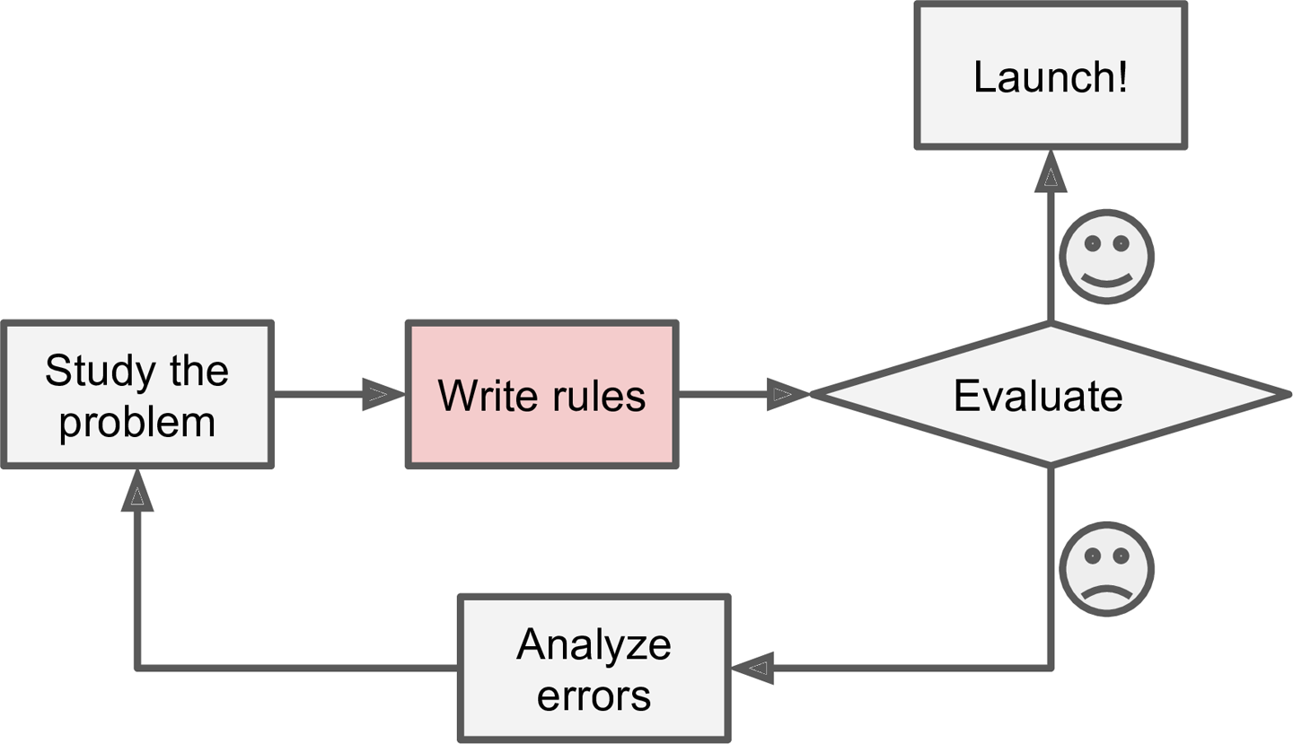
Spam Filtering
Traditional approach

Slide 23
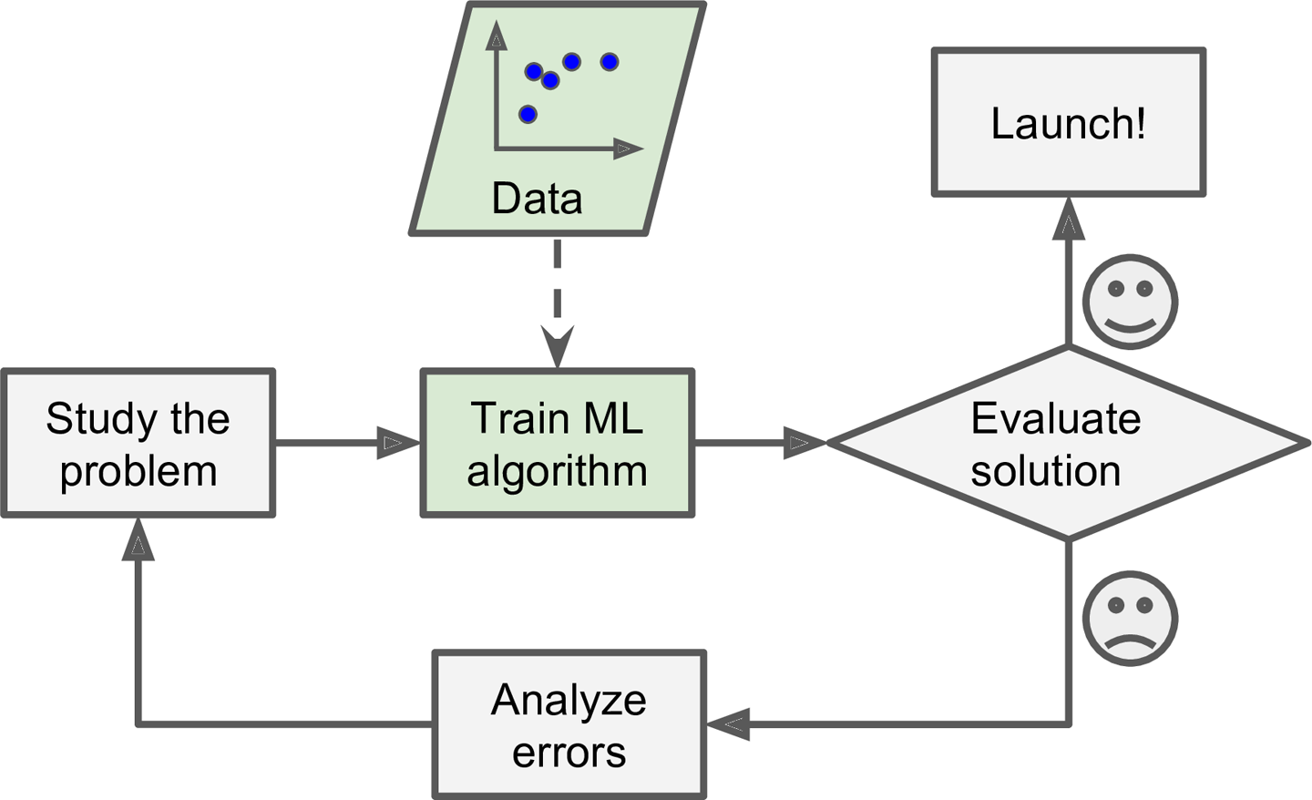
ML approach

Slide 24
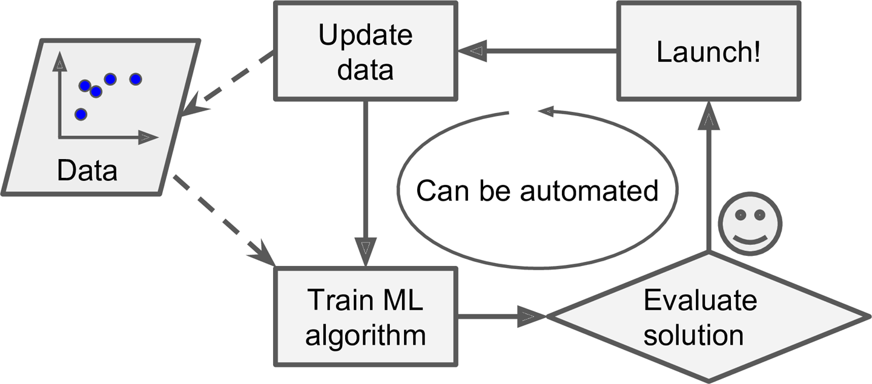
ML approach

Slide 25
ML is good for:
Problems for which existing solutions require a lot of hand-tuning or long lists of rules: one machine learning algorithm can often simplify code and perform better.
Complex problems for which there is no good solution at all using a traditional approach: the best machine learning techniques can find a solution.
Fluctuating environments: a machine learning system can adapt to new data.
Getting insights about complex problems and large amounts of data.

Slide 26

ML timeline

Slide 27
“A computer program is said to learn from experience E with respect to some task T and some performance P, if its performance on T, as measured by P, improves with E.”
-- Tom Mitchell, Computer Scientist, 1997
T = The thing we are trying to learn how to do.
P = The way we measure how well we’re doing.
E = The data the algorithm will learn from.

Slide 28
Experience E: the data
Most learning algorithms are allowed to experience a dataset, a collection of many examples or data points or instances.
Each example or data point is a collection of one or more features: each feature is usually a number, or a string representing a category (like blood type).
More complex data points are usually broken down. (e.g., speech, language, music, etc).

Slide 29
Performance P
We need some quantitative way to measure how well an ML algorithm is doing.
Ideas:
Accuracy
Error
Training set: set of examples used to train the ML algorithm.
Testing set: set of examples used to evaluate (test) the ML algorithm.

Slide 30
Types of ML systems
Supervised learning
Unsupervised learning
Semi-supervised learning
Reinforcement learning

Slide 31
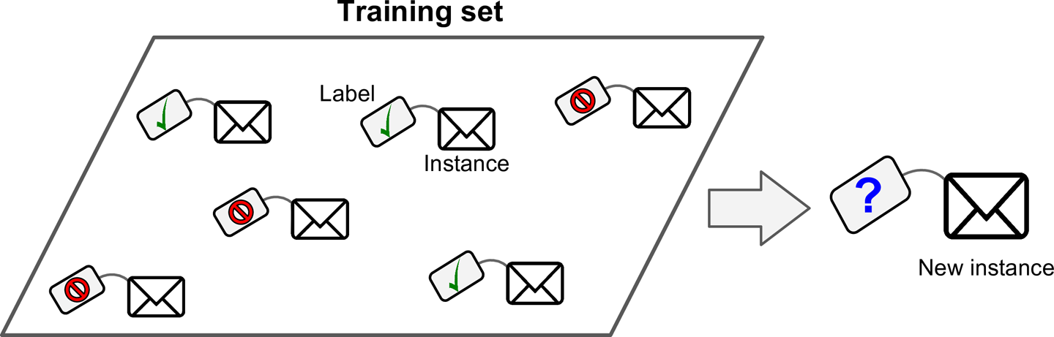
Supervised learning
Supervised learning algorithms receive data that is “labeled.”
The labels are the desired solutions (outputs).
Produces a system which can predict a new label for a previously-unseen input.
Notes:
Classification vs regression

Slide 32
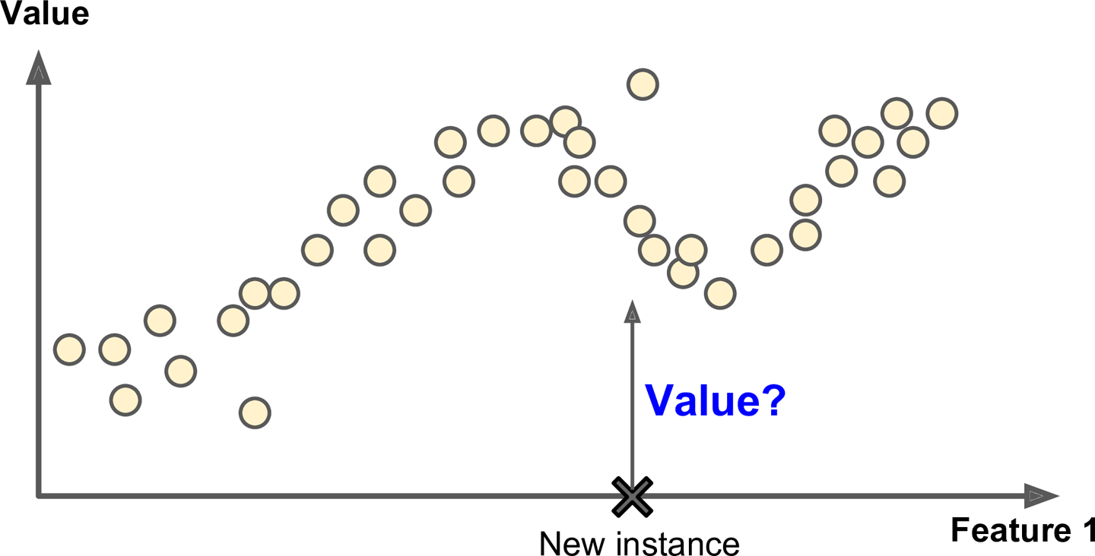
Regression

Slide 33
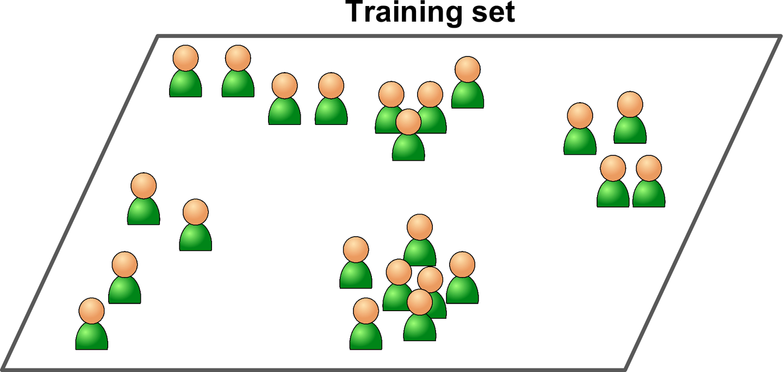
Unsupervised learning
Unsupervised ML algorithms receive unlabeled data.

Slide 34
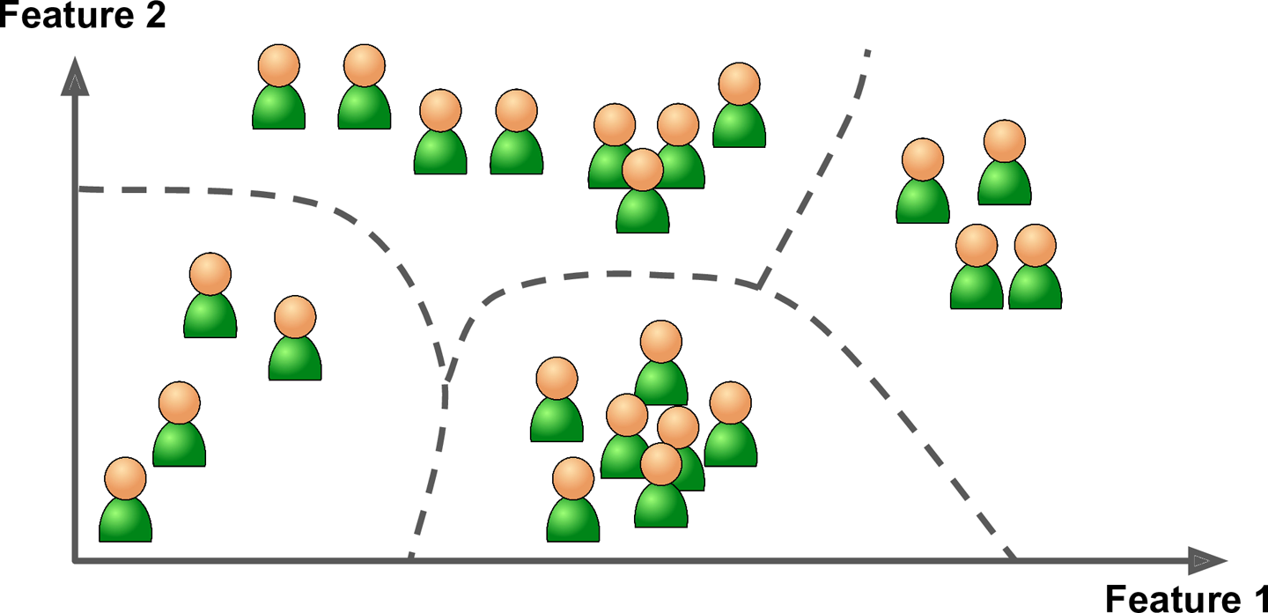
Notes:
Clustering, visualization algs, dimensionality reduction, anomaly detection

Slide 35
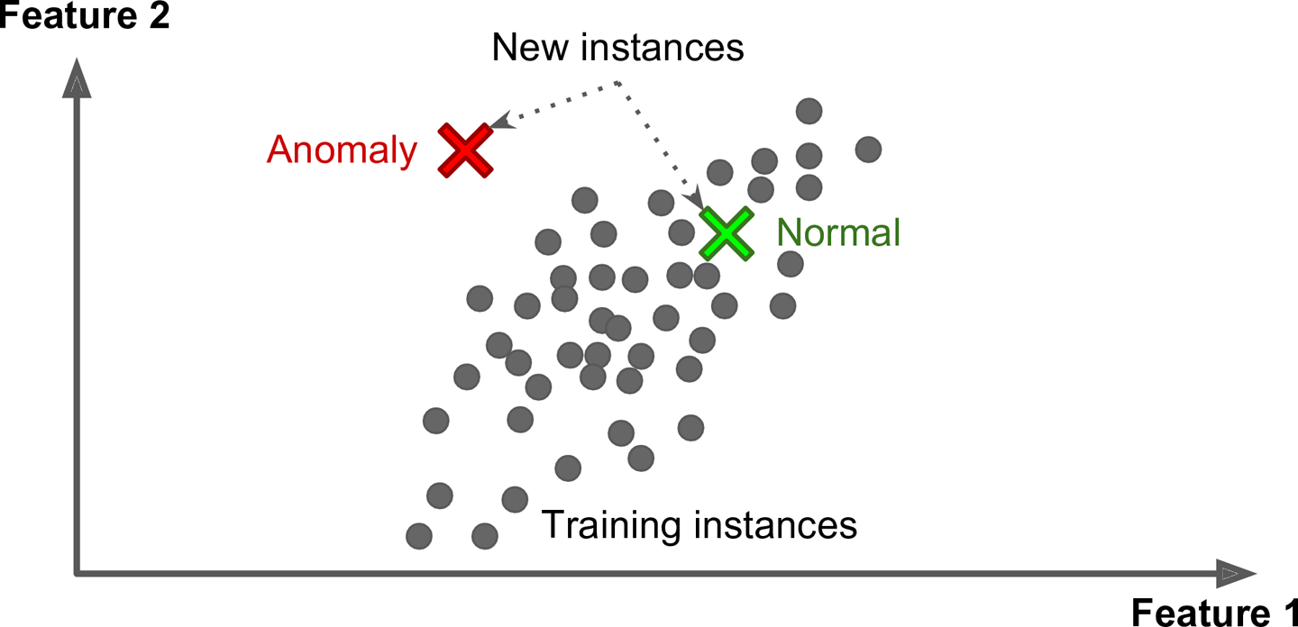

Slide 36
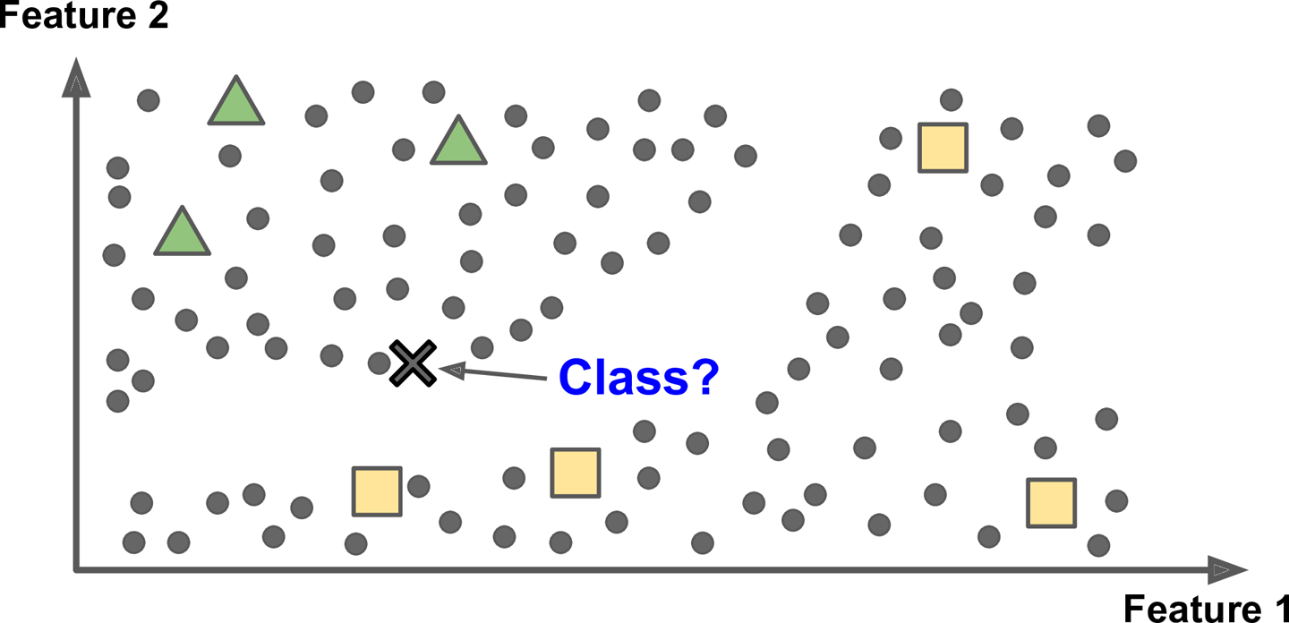
Semisupervised learning
Receive partially-labeled data.
Notes:
Photo labeling

Slide 37

Reinforcement learning

Slide 38
Batch vs online learning
Batch learning:
Algorithm trains on all the data at once, and after this is done, new data cannot be incorporated in.
If new data becomes available, the algorithm must be trained from scratch.
Online learning:
Algorithm can be trained incrementally, so if new data arrives, it can be incorporated without starting from scratch.

Slide 39
Batch learning
Notes:
Online learning algorithms can also be used to train systems on huge datasets that cannot fit in one machine’s main memory (this is called out-of-core learning). The algorithm loads part of the data, runs a training step on that data, and repeats the process until it has run on all of the data (see Figure 1-14).

Slide 40
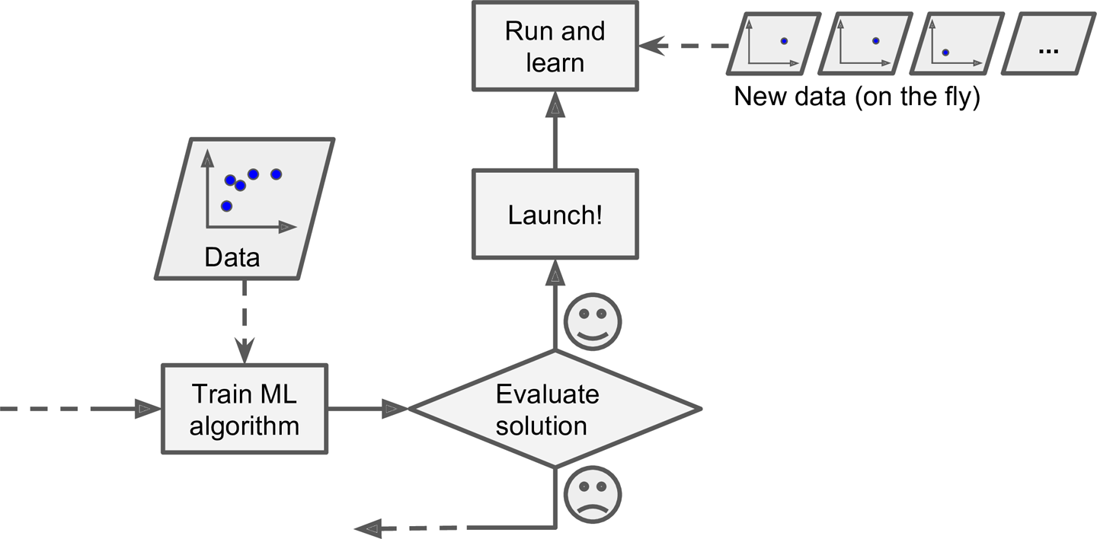
Online learning

Slide 41
Instance-based vs model-based
Instance-based:
An algorithm that makes new predictions by analyzing the training data (and comparing the data that we want a prediction about against the training data).
The training data must be kept in memory to make predictions.
Model-based:
An algorithm that builds a model of the training data and uses that model to make predictions.
The training data can be discarded after the model is created.
Notes:
One more way to categorize Machine Learning systems is by how they generalize. Most Machine Learning tasks are about making predictions. This means that given a number of training examples, the system needs to be able to generalize to examples it has never seen before. Having a good performance measure on the training data is good, but insufficient; the true goal is to perform well on new instances.
Dog vs cats example

Slide 42
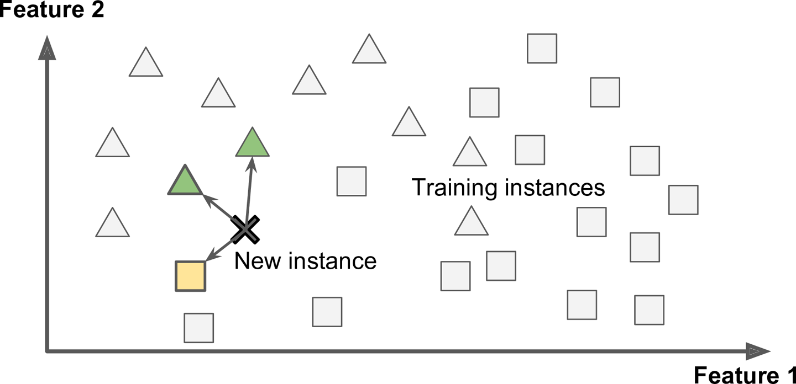
Instance-based

Slide 43
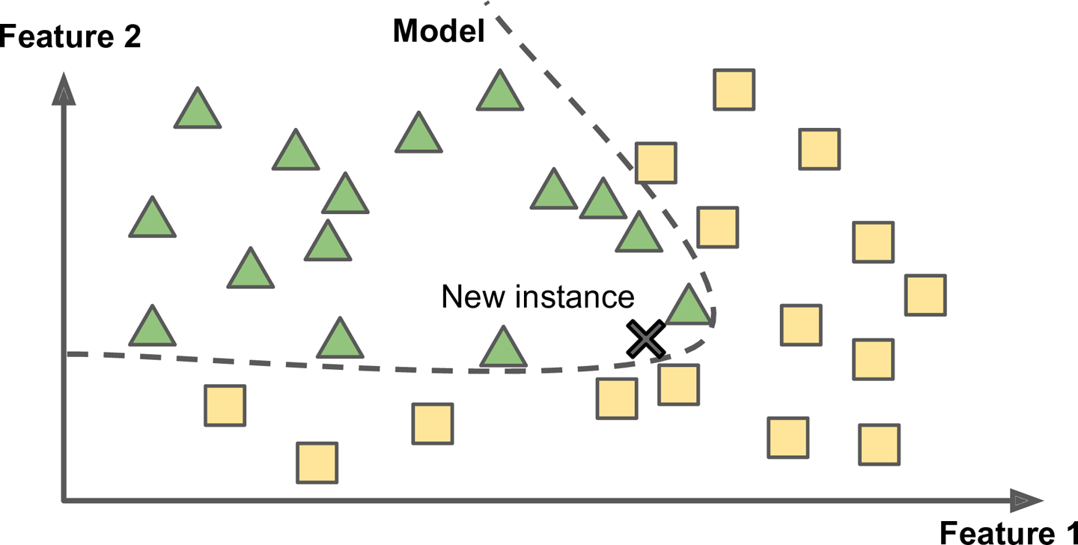
Model-based

Slide 44
Main challenges of ML
Insufficient quantity of training data
Non-representative training data
Poor-quality data
Irrelevant features
Overfitting the training data
Underfitting the training data
Notes:
#2 training data must be representative of the data you want to generalize to

Slide 45
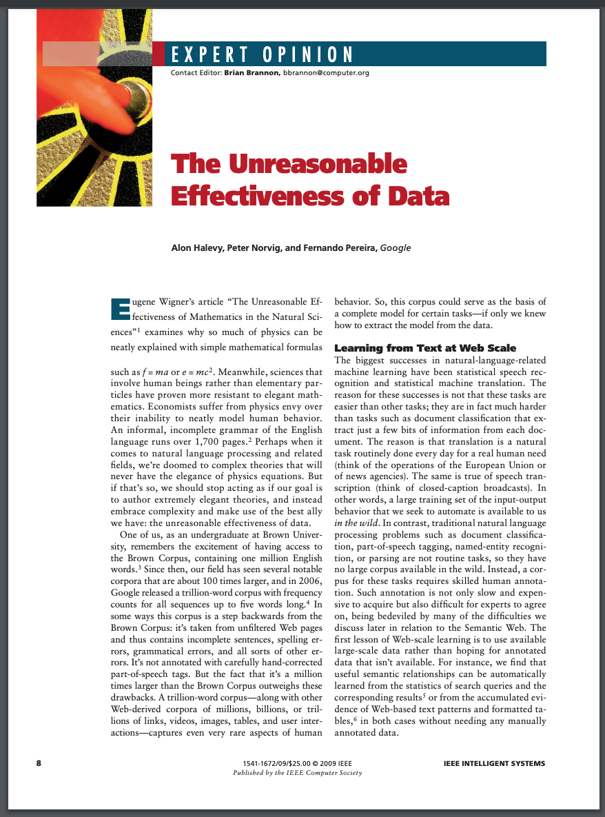

Slide 46
Main challenges of ML
Insufficient quantity of training data
Non-representative training data
Poor-quality data
Irrelevant features
Overfitting the training data
Underfitting the training data
Notes:
#2 training data must be representative of the data you want to generalize to

Slide 47
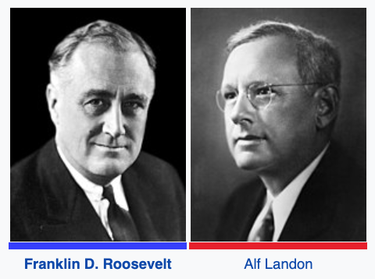
1936 Presidential Election

Slide 48
This election is notable for The Literary Digest poll, which was based on ten million questionnaires mailed to readers and potential readers; 2.27 million were returned. The Literary Digest had correctly predicted the winner of the last five elections, and announced in its October 31 issue that Landon would be the winner with 57.1% of the vote (v Roosevelt) and 370 electoral votes.

Slide 49
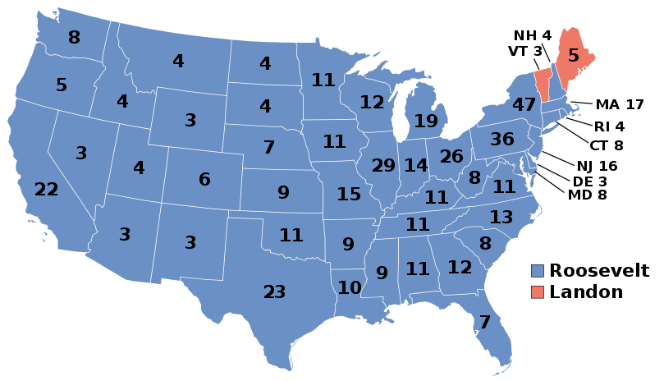

Slide 50
Main challenges of ML
Insufficient quantity of training data
Non-representative training data
Poor-quality data
Irrelevant features
Overfitting the training data
Underfitting the training data
Notes:
#2 training data must be representative of the data you want to generalize to

Slide 51
Testing and Validation
Training set and testing set
Validation set
Cross-validation
Notes:
For example, if the most suitable classifier for the problem is sought, the training data set is used to train the different candidate classifiers, the validation data set is used to compare their performances and decide which one to take and, finally, the test data set is used to obtain the performance characteristics such as accuracy, sensitivity, specificity, F-measure, and so on. The validation data set functions as a hybrid: it is training data used for testing, but neither as part of the low-level training nor as part of the final testing.

